Slide 1
Long acting calinurin inhibitors, principls and benefits
HAMID Tayebi khosroshahi, MD

Slide 2
Introduction
Immunosuppression management in clinical transplantation aims to balance delivery of efficacy against adverse reactions using therapeutic drug monitoring.
Another important aspect of managing immunosuppression is ensuring compliance by the transplant patient in order to sustain an allograft free from rejection.
Hence, most studies on immunosuppressive agents focus on efficacy and safety, with the goal of achieving the best possible allograft function with minimal adverse effects.

Slide 3
Over the years, immunosuppressive regimens used in transplantation have evolved.
In current practice, the most commonly used immunosuppressive regimen includes a calcineurin inhibitor (cyclosporine, tacrolimus) and an antimetabolite (mycophenolate mofetil, azathioprine), with or without corticosteroids.3
.

Slide 4
Increasing availability of a broad range of immunosuppressive medications and formulations opens possibilities of designing regimens that achieve
1- the best possible graft outcome along with
2- minimal adverse effects while, at the same time,
3- maximizing treatment adherence among transplant recipients

Slide 5
Rationale for once-daily tacrolimus in clinical practice
Conventional immunosuppression in the modern era involves twice-daily oral dosing of calcineurin inhibitors and antiproliferatives such as mycophenolate mofetil.
This need for twice-daily dosing schedules has been associated with nonadherence.
Previous reviews directed at recipients transplanted between the late 1980s and mid-2000s showed that the prevalence of nonadherence to immunosuppressive medications averaged about 25%.

Slide 6
This nonadherence to medications was felt to contribute to about 20% of late acute rejection episodes and 16%–36% of graft losses.2
It would therefore be reasonable to expect that a simplified immunosuppressive regimen that involves less frequent drug dosing would improve both patients’ medication compliance and long-term allograft outcomes.1

Slide 7
The recent availability of once-daily tacrolimus formulation could thus offer the potential benefit of improved medication compliance and possibly better allograft outcomes by decreasing pill burden and thereby simplifying dosing schedule.
Since there is more extensive experience in the use of the twice-daily tacrolimus formulation in clinics, the increased utilization of once-daily tacrolimus demands a review of evidence that this formulation is comparable, or noninferior if not superior, to twice-daily tacrolimus in terms of safety and efficacy.

Slide 8
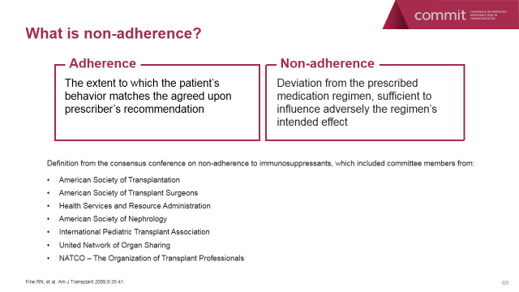

Slide 9
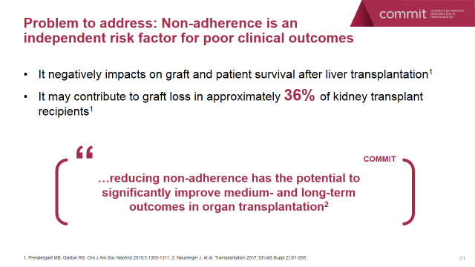

Slide 10
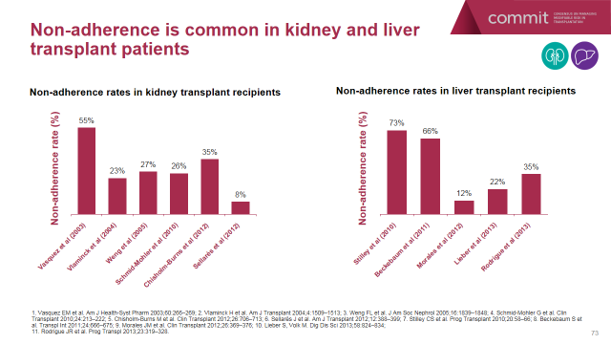

Slide 11
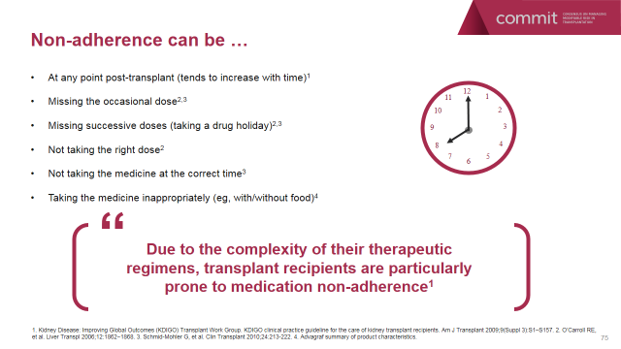

Slide 12
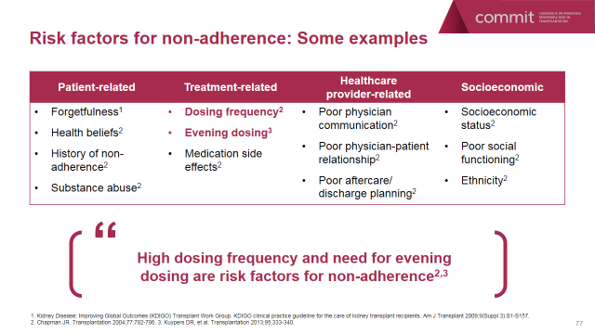

Slide 13
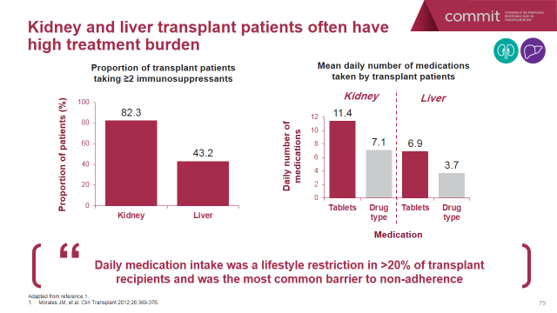

Slide 14
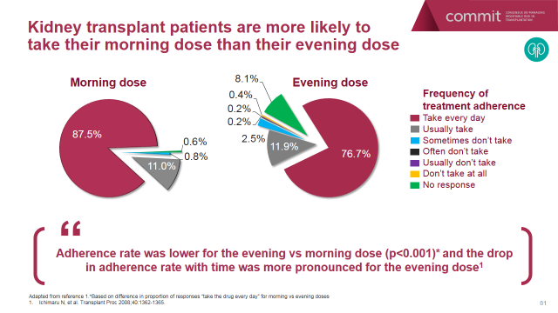

Slide 15
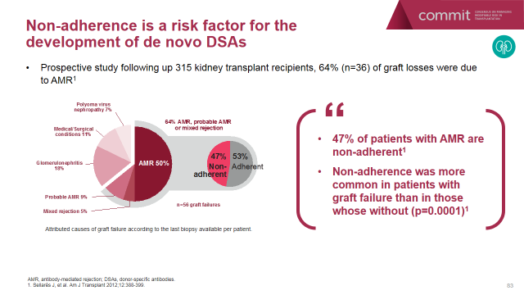

Slide 16
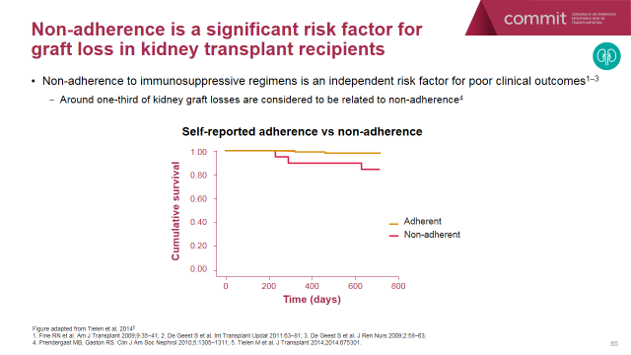

Slide 17
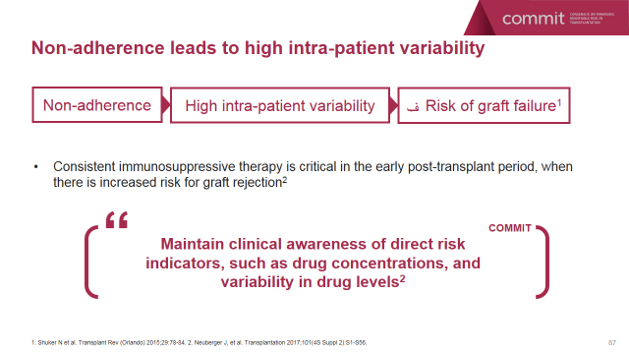

Slide 18
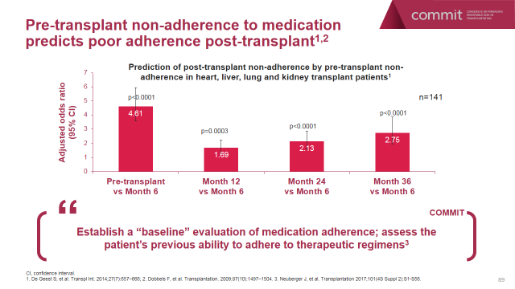

Slide 19
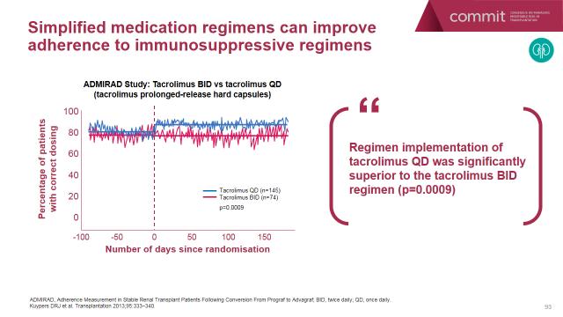

Slide 20
Once-daily tacrolimus: dosing and pharmacokinetics
Compared to twice-daily tacrolimus, once-daily tacrolimus is typically released more distally in the gastrointestinal tract by virtue of its dissolution properties. It has the same active component and metabolism as twice-daily tacrolimus.
Recommended doses for once-daily tacrolimus start at 0.2–0.3 mg/kg/day within 24 hours of kidney transplantation and 0.1–0.2 mg/kg/day within 12–18 hours of liver transplantation.

Slide 21
In a randomized, four-way, crossover trial conducted in six healthy white male subjects, various formulations of tacrolimus were administered to be activated in the stomach, proximal small intestines, distal small intestines, and ascending colon, and were tracked using radiolabeled material.
Results showed that tacrolimus was absorbed in the small intestines as well as the colon.
Pharmokinetic (PK) studies showed that, although there was a substantial intersubject variation in PK parameters, there were no statistical differences in the peak concentration (Cmax) and areas under the curve (AUCs) achieved with the different tacrolimus regimens released at various sites of the gastrointestinal tract.

Slide 22
Phase I PK studies among healthy volunteers showed that once- and twice-daily tacrolimus administered based on a milligram-to-milligram conversion achieved similar AUC and trough levels (minimum concentration [Cmin]).5
Once-daily tacrolimus was noted to have a lower Cmax and a longer time to achieve maximal concentration (Tmax) compared to twice-daily tacrolimus.5
The effects of food intake on the PK profile of once- and twice-daily tacrolimus are similar in that Cmax and AUC decreased by about 20%–25%, while Tmax increased by 80%.5

Slide 23
Phase II PK studies involving adult kidney, liver, and heart transplant patients showed that the AUC and trough levels achieved with once-daily tacrolimus were within the 80%–125% range in comparison with twice-daily tacrolimus, suggesting bioequivalence in PKs between the two tacrolimus formulations.5
In a Japanese study that compared once- with twice-daily tacrolimus in 102 de novo kidney transplant recipients, PK studies revealed similar AUC, Cmax, and trough levels between the two formulations.

Slide 24
In a Phase II study of 47 stable kidney transplant patients converted from twice- to once-daily tacrolimus, PK studies done on days 7 (baseline prior to conversion), 14, and 21 revealed lower Cmax, peak–trough ratio, and percent fluctuation as well as significantly longer Tmax for once-daily tacrolimus compared to the twice-daily formulation.
Similar observations were noted in 57 liver transplant recipients converted from twice- to once-daily tacrolimus.10 The greater bioavailability of once-daily tacrolimus allowed similar AUC exposure using a dose that is about 30% lower than the twice-daily formulation.9,10

Slide 25
Among pediatric kidney transplant recipients, AUC and trough were noted to decrease after conversion to once-daily tacrolimus.
These differences were statistically significant in a PK study involving 34 patients, and not statistically significant in another study involving 19 patients.
*PK studies conducted on 19 stable lung transplant patients converted to once-daily tacrolimus showed that the bioavailability of tacrolimus is similar with once- and twice-daily formulations. AUC and trough levels were similar in both formulations.13

Slide 26
Based on the above, it is recommended that tacrolimus be taken on an empty stomach at least 1 hour before or 2–3 hours after a meal.
Given the overall similarities in the PK profile of both tacrolimus formulations, therapeutic drug monitoring for both once- and twice-daily tacrolimus is done based on the Cmin or trough level, measured 24 hours from the last once-daily tacrolimus dose and 12 hours after the twice-daily tacrolimus dose.

Slide 27
The pharmocokinetics of both tacrolimus formulations are affected by patient age, race, hematocrit, and cytochrome P (CYP) 3A5 genotype.
Between-subject PK variability is similar between once- and twice-daily tacrolimus.
However, within-subject inter-occasion PK variability, a measure of stability of drug exposure over time, is lower with once-daily tacrolimus.

Slide 28
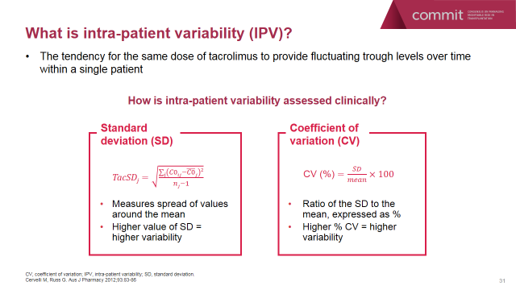

Slide 29
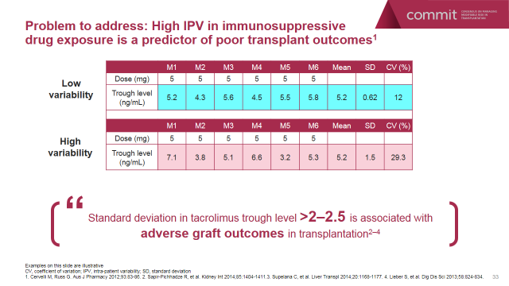

Slide 30
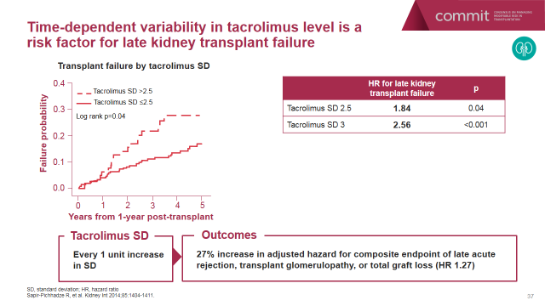

Slide 31
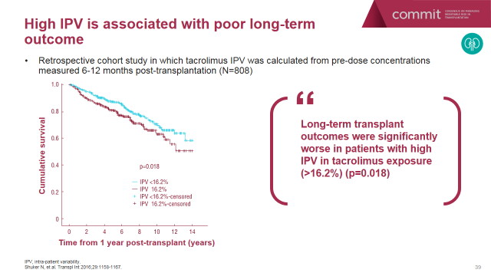

Slide 32
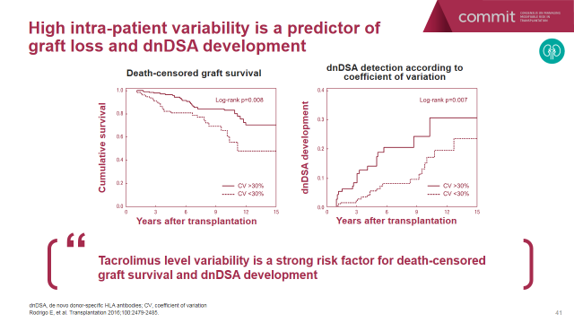

Slide 33
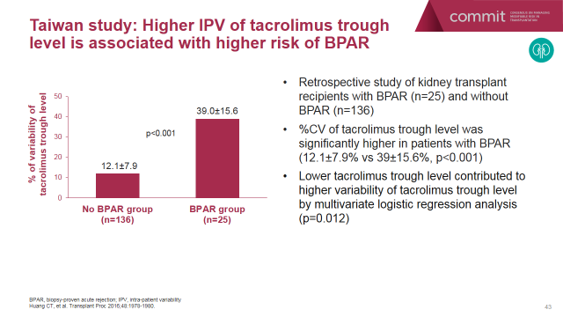

Slide 34
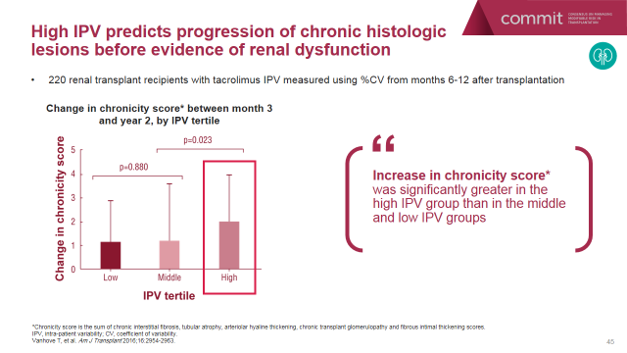

Slide 35
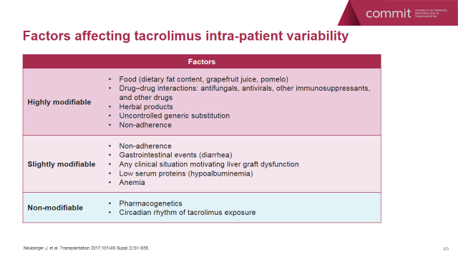

Slide 36
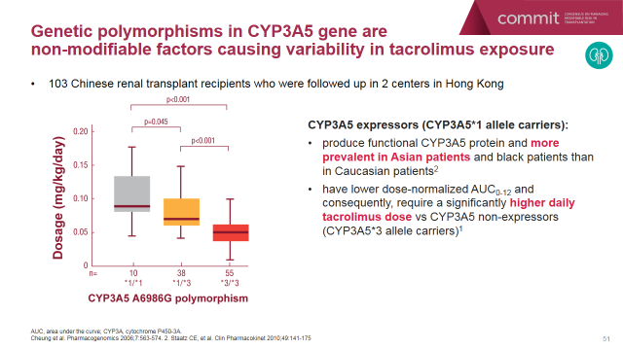

Slide 37
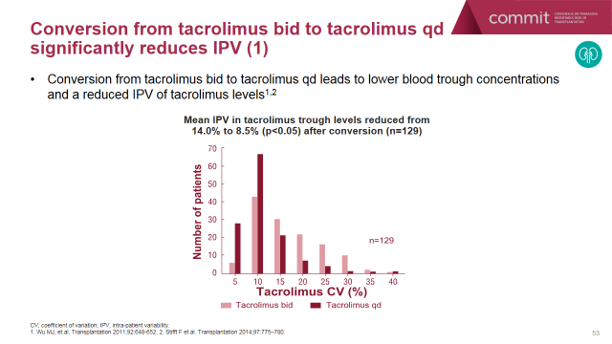

Slide 38
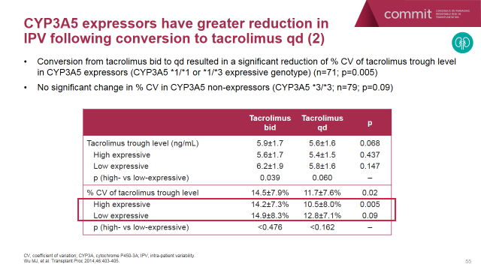

Slide 39
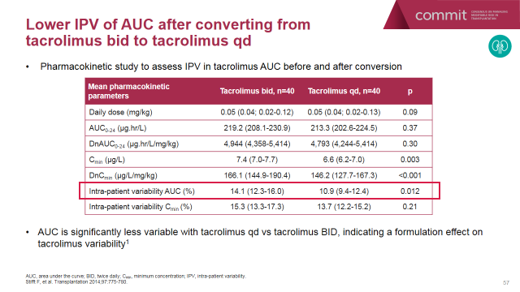

Slide 40
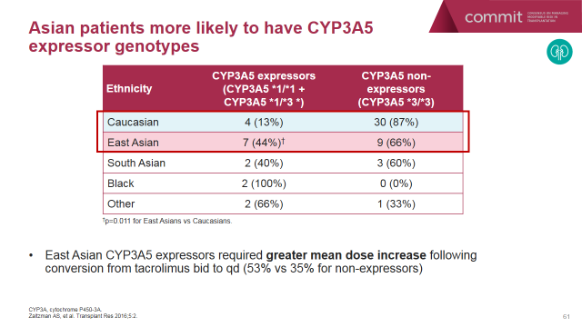

Slide 41
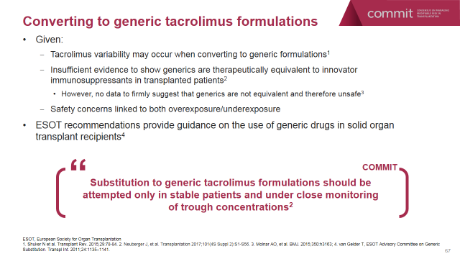

Slide 42
As could be expected, tacrolimus dose was significantly higher in the high-expressive genotype group both before and after conversion to once-daily tacrolimus. Conversion from twice- to once-daily tacrolimus resulted in a decrease in variability in the tacrolimus trough levels among patients with high-expressive genotype.

Slide 43
Despite a lack of studies involving drug interactions with once-daily tacrolimus, it is reasonable to believe that once- and twice-daily tacrolimus would exhibit similar drug interaction patterns as they share the same active constituent.5
The similarity in the PK profiles of once- and twice-daily tacrolimus
Both formulations have similar AUC and trough levels, although there was a trend toward lower, although often not statistically significant, AUC and Cmax with once-daily tacrolimus.
Once-daily tacrolimus could allow for minimization in intrapatient inter-occasion variability in Cmin, especially among patients with CYP3A5 high-expressive genotype.

Slide 44
Whether the PK bioequivalence between the two tacrolimus formulations translates to the noninferiority of once-daily tacrolimus compared to twice-daily tacrolimus can only be determined by efficacy studies that compare outcomes of patients who received either formulation; these are discussed in the following section.

Slide 45
Efficacy studies on once-daily tacrolimus
Kidney transplantation
A randomized, open-label, multicenter, three-armed noninferiority trial18 involving 638 de novo kidney transplant recipients, comparing the efficacy of once- and twice-daily tacrolimus with cyclosporine, showed that both tacrolimus formulations were noninferior to cyclosporine, as measured by efficacy failure rate, consisting of death, graft failure, and biopsy-proven acute rejection (BPAR) at 1 year.

Slide 46
The rates of BPAR at 6 months and 1 year were significantly lower in the twice-daily tacrolimus group (3.8% and 7.5%, respectively) compared to the cyclosporine group (11.8% and 13.7%, respectively).
BPAR rates at 6 months and 1 year were not statistically different between the once-daily tacrolimus (7.9% and 10.3%, respectively) and cyclosporine groups.

Slide 47
It is worth noting that about one-third of the patients who received once-daily tacrolimus had trough levels below target during the early post-transplant period day 3).
There was a trend toward higher mean trough levels achieved among patients in the twice-daily tacrolimus group who did not develop BPAR compared to those who developed BPAR on either tacrolimus formulation.

Slide 48
Another randomized, double-blind, multicenter noninferiority trial with 667 de novo kidney transplant patients compared the efficacy of once-daily tacrolimus with twice-daily tacrolimus.
All subjects received mycophenolate mofetil and corticosteroids, without antibody induction.
In this trial, the once-daily tacrolimus group was found to have slightly higher BPAR rates at 24 weeks and 12 months.19

Slide 49
It is notable that the treatment differences between once- and twice-daily tacrolimus fell outside the 10% prespecified noninferiority margin for the primary and secondary endpoints, suggesting that once-daily tacrolimus may not be noninferior to twice-daily tacrolimus.

Slide 50
It is also worth noting that the mean tacrolimus trough achieved in the once-daily tacrolimus group during the first week post-transplant was significantly lower compared to the twice-daily tacrolimus group.

Slide 51
Whether this relatively lower tacrolimus trough early post-transplant in the once-daily tacrolimus group contributed downstream to higher BPAR rates deserves further investigation. Even more importantly, future experience will need to verify whether this rejection risk may be modifiable by optimizing drug exposure with increase in the daily dose of the drug.
Overall, results showed comparable patient and allograft survival, renal function, and adverse effects between the two formulations.5,19

Slide 52
In an open-label, randomized study (Optimising ImmunoSuppression After Kidney Transplantation with ADVAGRAF [OSAKA] trial), 976 adult kidney transplant patients were grouped into four arms to receive:
1- twice-daily tacrolimus0.2 mg/kg/day (arm 1);
2- once-daily tacrolimus 0.2 mg/kg/day (arm 2);
3- once-daily tacrolimus 0.3 mg/kg/day (arm 3), all with mycophenolate mofetil and corticosteroids tapered to 5 mg/day over 24 weeks; or
4- once-daily tacrolimus 0.2 mg/kg/day with basiliximab, mycophenolate mofetil, and corticosteroids given only perioperatively (arm 4).

Slide 53
About 10% of the patients had kidney transplants from living donors, while about 50% had extended-criteria donor kidneys.
The primary endpoint was efficacy failure, a composite of graft loss, acute rejection detected on for-cause biopsy, or graft dysfunction (glomerular filtration rate 40 mL/min) at 24 weeks.
The majority of BPARs were mild to moderate and steroid-sensitive.
Results showed that once-daily tacrolimus 0.2 mg/kg/day without induction therapy (arm 2) had similar efficacy to twice-daily tacrolimus 0.2 mg/kg/day (arm 1).

Slide 54
In a multicenter, open-label, controlled, noninferiority trial (Multicenter Evaluation of LCP Tacro tablets [MELT]) involving stable kidney transplant recipients, 324 patients were randomized to either remain on twice-daily tacrolimus or be converted to once-daily tacrolimus.
The primary efficacy endpoint was efficacy failure that included death, graft failure, BPAR, or loss to follow-up within 12 months of follow-up.

Slide 55
There were four cases of efficacy failure in both groups: two deaths due to cardiac arrest and two episodes of BPAR in the once-daily tacrolimus group, and one death due to lung cancer, two episodes of BPAR, and one loss to follow-up in the twice-daily tacrolimus group.
All deaths were deemed unrelated to the study drug. Safety outcomes were similar between the two groups.22

Slide 56
In an open-label prospective observational study on Japanese kidney transplant recipients, 256 patients received once-daily tacrolimus at the onset of kidney transplant, while 106 were converted to once-daily tacrolimus post-transplant.
The subjects were observed over 24 weeks.
Among the subjects started on once-daily tacrolimus, the cumulative incidence of patient and graft survival was 98.2%.
Acute rejection rate was 16.1%, of which 6.3% was steroid-resistant.
Among the patients converted to once-daily tacrolimus post-transplant, there was one reported case of graft loss due to patient death from accident and one episode of steroid-sensitive acute rejection.23

Slide 57
In an open-label, prospective, randomized controlled trial in Japanese living kidney transplant recipients, 102 patients were randomized to receive either once- (n=50) or twice-daily (n=52) tacrolimus at the onset of transplantation.
Protocol kidney biopsies were performed at day 14. Additional protocol kidney biopsies were performed within 6–12 months after transplantation.
One-year patient and graft survival were 100% for both groups. *Acute cellular rejection (at least Banff 1A) was reported in one patient in the once-daily tacrolimus group and in five patients in the twice-daily tacrolimus group.
*Antibody-mediated rejection was noted in four patients in each group.
Differences in BPAR incidences did not reach statistical significance.8

Slide 58
Another Japanese study looked into the safety and efficacy of once-daily tacrolimus by converting 33 kidney transplant patients, who were at least 1 year post-transplant, from twice- to once-daily tacrolimus.
Serum creatinine, total cholesterol, uric acid, and fasting glucose were measured prior to and after conversion, all of which did not have any significant change with conversion.
There were also no reported cases of rejection or infection after conversion to once-daily tacrolimus.24

Slide 59
In a multicenter study of 128 stable adult kidney transplant recipients converted from twice- to once-daily tacrolimus followed over 12 weeks, the once-daily formulation was found to be noninferior to twice-daily tacrolimus.
Patient and graft survival were both 100%.
There were no reported cases of BPAR. Renal function remained stable after conversion to once-daily tacrolimus. The patients’ blood pressure and hemoglobin A1c also remained fairly unchanged.25

Slide 60
Slatinska et al performed a retrospective review of 589 stable adult kidney transplant recipients who were converted from twice- to once-daily tacrolimus. Concomitant immunosuppressive medications remained unchanged.
Results showed that a milligram-to-milligram conversion from twice- to once-daily tacrolimus did not have a significant change in the total tacrolimus dose and trough levels.
There was less interpatient variability of drug exposure observed after conversion to the once-daily formulation.

Slide 61
At 12 months after conversion, patient survival was 99%, while graft survival was 96.3%.
Renal function remained fairly stable after conversion, with glomerular filtration rate of about 46 mL/min throughout the observation period. There were 14 (2.4%) reported cases of BPAR: six were borderline rejection; two were Banff IA; three were Banff IB; and three were Banff IIA. Three developed BPAR within 3 months of conversion to once-daily tacrolimus. The cases of Banff IIA rejection had subtherapeutic tacrolimus trough levels (<3 ng/mL). All cases of BPAR were successfully treated with steroids.26

Slide 62
Wu et al conducted a retrospective cohort study on 199 stable Chinese kidney transplant recipients converted from twice- to once-daily tacrolimus. Two patients (1%) developed BPAR after conversion, both of whom were noted to have subtherapeutic tacrolimus trough levels (3 ng/mL).27

Slide 63
In a retrospective study of 119 living donor kidney transplant recipients (90 patients on once-daily tacrolimus and 29 patients on twice-daily tacrolimus), protocol biopsies at 3 and 12 months were reviewed.
Results showed that the frequency of subclinical rejection were similar between once- and twice-daily tacrolimus formulations. Interstitial fibrosis and tubular atrophy was less frequent and less severe in patients on once-daily tacrolimus at 12 months.28

Slide 64
Safety and tolerability in long-term use
Tacrolimus alters glucose and lipid metabolism.
Thus, it has been suggested that avoidance of high tacrolimus Cmax, often associated with the once-daily formulation, may decrease the incidence of hyperglycemia and hyperlipidemia among transplant patients.5
A study involving 20 stable kidney transplant patients showed a significant decrease in the incidence of hyperglycemia and hypertriglyceridemia following conversion from twice- to once-daily tacrolimus.
Results showed that HOMA-β increased while hemoglobin A1c decreased significantly after 4 weeks of conversion to once-daily tacrolimus.

Slide 65
In the randomized trial comparing both tacrolimus formulations, it was noted that constipation, gastroenteritis, paresthesia, fatigue, lower abdominal pain, pharyngitis, cytomegalovirus, and BK virus infections (2.1% versus 0.3%, P=0.037) were more frequently reported in the once-daily tacrolimus group.
On the other hand, incision-site complications, graft dysfunction, urinary tract infection, cough, and bacterial infections were less frequently observed in the once-daily tacrolimus group.5,19

Slide 66
The MELT trial reported serious adverse events in 36 (22%) patients in the once-daily tacrolimus group and in 26 (16%) in the twice-daily tacrolimus group (P= nonsignificant).
The most frequently reported adverse events were urinary tract infection, diarrhea, nasopharyngitis, upper respiratory tract infection, headache, edema, hypertension, and increased serum creatinine.22

Slide 67
In a Japanese prospective, observational study, common adverse drug reactions reported among the subjects started on once-daily tacrolimus included infection (23.6%), most commonly with cytomegalovirus; renal disorder (6.8%); and glucose intolerance (5.6%).
On the other hand, among the patients converted to once-daily tacrolimus post-transplant, common adverse reactions noted were infections, most often herpes zoster and nasopharyngitis.

Slide 68
In the retrospective review of 589 adult kidney transplant patients converted from twice- to once-daily tacrolimus by Slatinska et al, there were 19 (3%) reported cases of malignancy, six (1%) cases of thrombotic microangiopathy, and three (0.5%) cases of severe vascular changes, all of which were addressed by conversion of once-daily tacrolimus to sirolimus.
The 19 cases of malignancy consisted of three cases of squamous cell skin cancer, two cases of basal cell skin cancer, one post-transplant lymphoproliferative disorder, seven genitourinary cancers, three respiratory cancers, two gastrointestinal cancers, and one thyroid cancer.

Slide 69
Twenty-five (4.2%) patients had worsening hypertension necessitating increase in antihypertensive regimen, while nine (1.5%) patients with pre-transplant diabetes had persistent hyperglycemia and required conversion from oral hypoglycemic to insulin.
Other frequently reported adverse events were urinary tract infection (3.7%), liver enzyme elevation (3.4%), anemia (2.7%), leukopenia (2%), and common warts (2.6%).26

Slide 70
In the Chinese study of 199 kidney transplant recipients, reported adverse events were malaise (3.5%), headache (3%), oral ulcer (1.5%), and skin rash (1%). Only one patient developed an unspecified neoplasia.
Seven patients noted deterioration in renal function and were converted back to twice-daily tacrolimus.27

Slide 71


Slide 72
